Slide 1
Vimm's Lair Site Hosting
Anthony Jamieson, Bryanna Parkoff, Joseph Drouillard

Slide 2
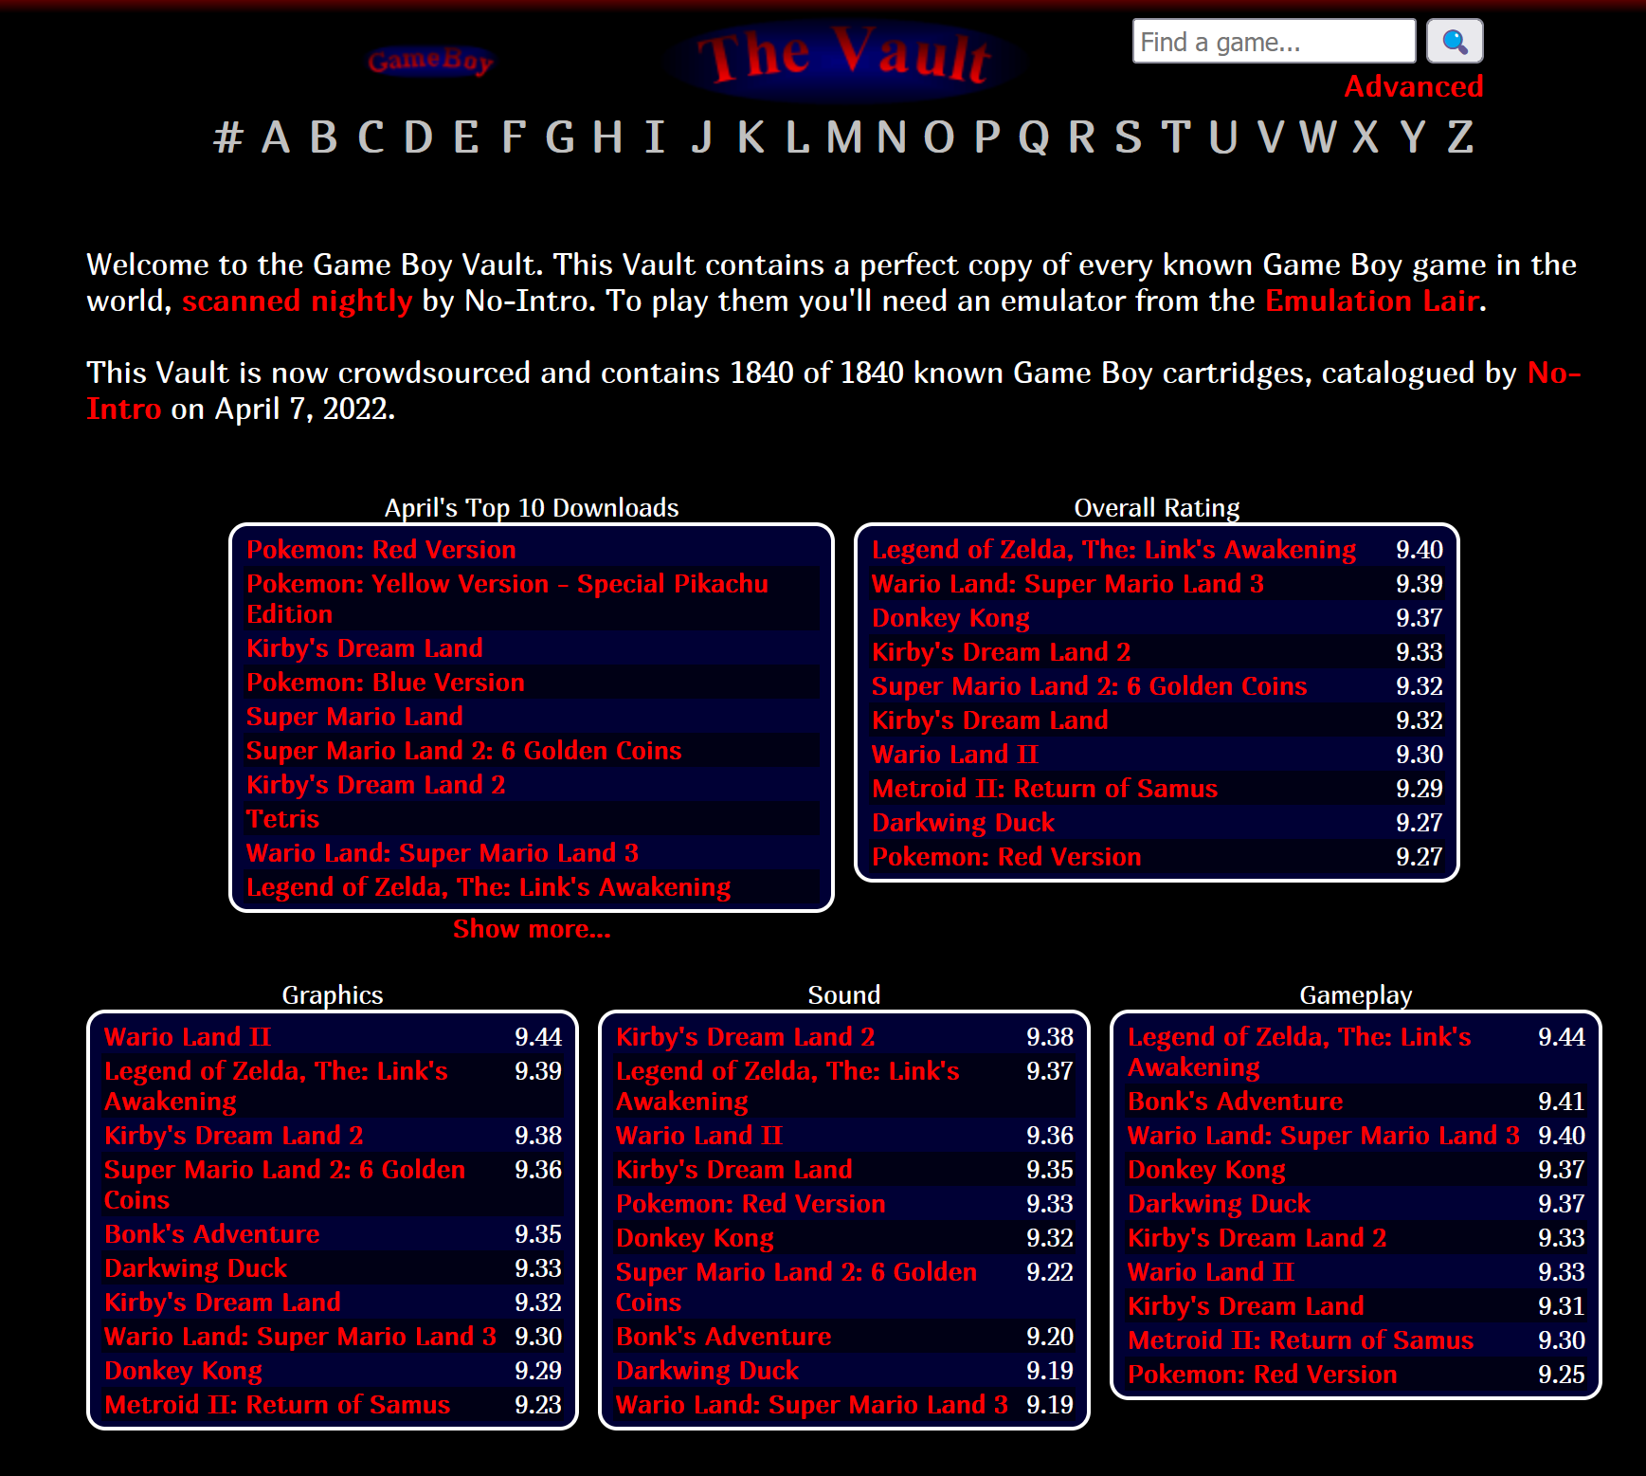
Executive Summary
Main purpose was to host a video game repository website on AWS
Proof of concept was hosted as a static website through AWS S3
Website Vimm's Lair (vimm.net) was cloned using HTTrack
HTML files edited using Brackets
HTML and ISO files for the video games were uploaded to the bucket
Website is largely functional and within scope
A minority of links are buggy or broken
AWS CloudWatch is used to gather data analytics

Slide 3
Milestones

Slide 4

Milestone 1: Cloud Architecture

Slide 5
Cloud Architecture
The center of our architecture was an S3 bucket "gamekingdom7"
Auto-scaling and load balancing was not an important consideration
S3 buckets have innate scalability
Default bucket policy permits object retrieval
Public access is granted for the bucket unconditionally
The ACLs only grant write permissions to the bucket owner

Slide 6
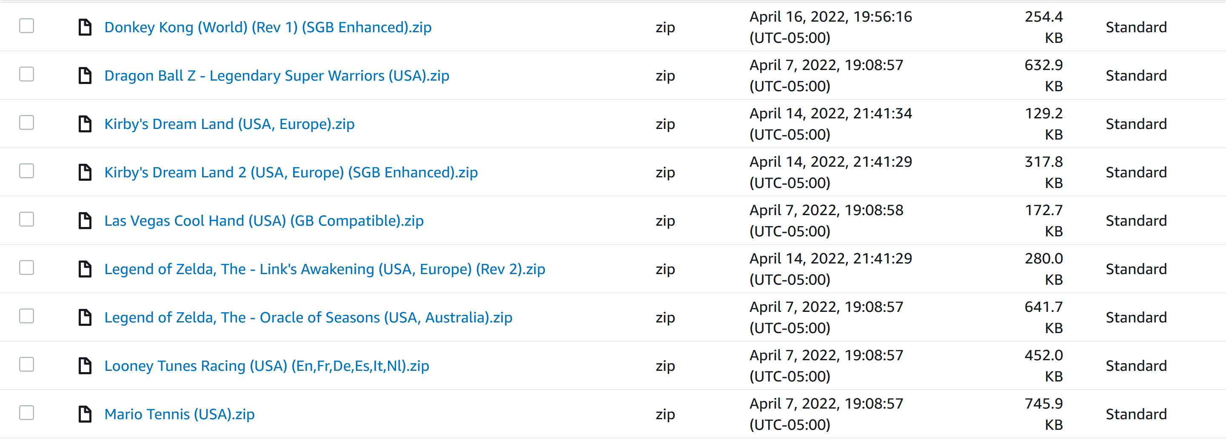
Cloud Architecture (continued)
S3 bucket hosts a static website cloned from part of the site vimm.net
Necessary HTML and ISO files were uploaded to the main bucket
Brackets was used to connect the download links to bucket endpoints of the respective ISO files by editing the cloned HTML

Slide 7
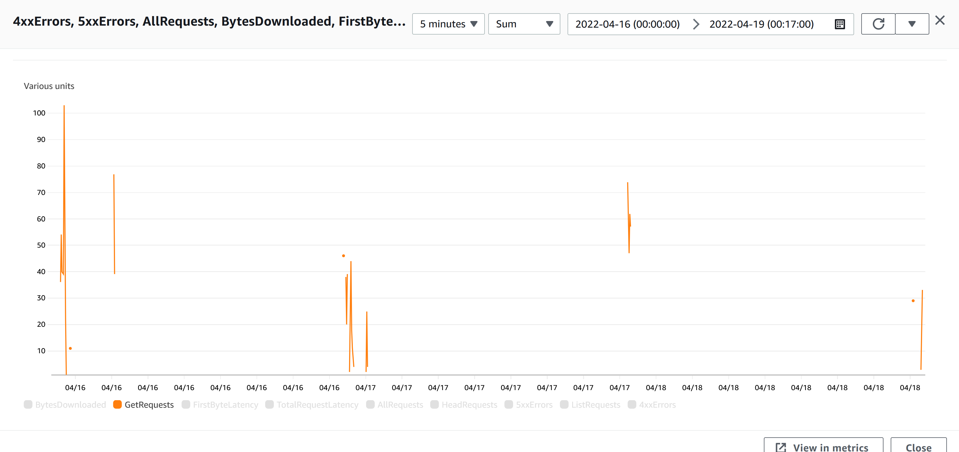
Data Analytics
CloudWatch is used to monitor request metrics for the static website
There were 9 applicable metrics for our S3 bucket
GET, HEAD, LIST, and all requests: First byte latency and total request latency; bytes downloaded; 4xx and 5xx errors

Slide 8
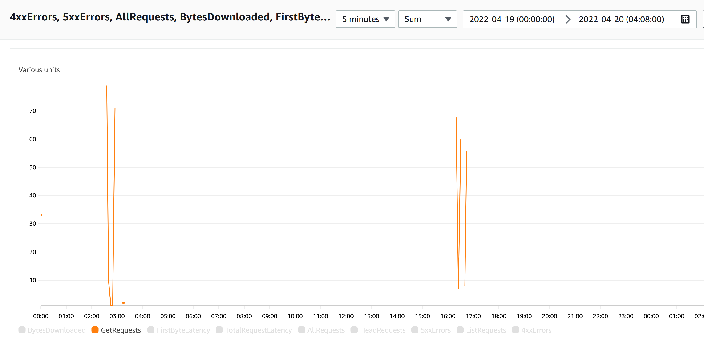
GET Request
HTTP requests used to pull objects from a server

Slide 9
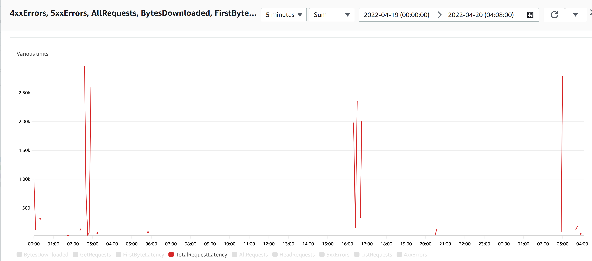
Total request Latency
Number of milliseconds between the first and last byte sent on each request

Slide 10

Milestone 2: Website Setup/Deployment

Slide 11
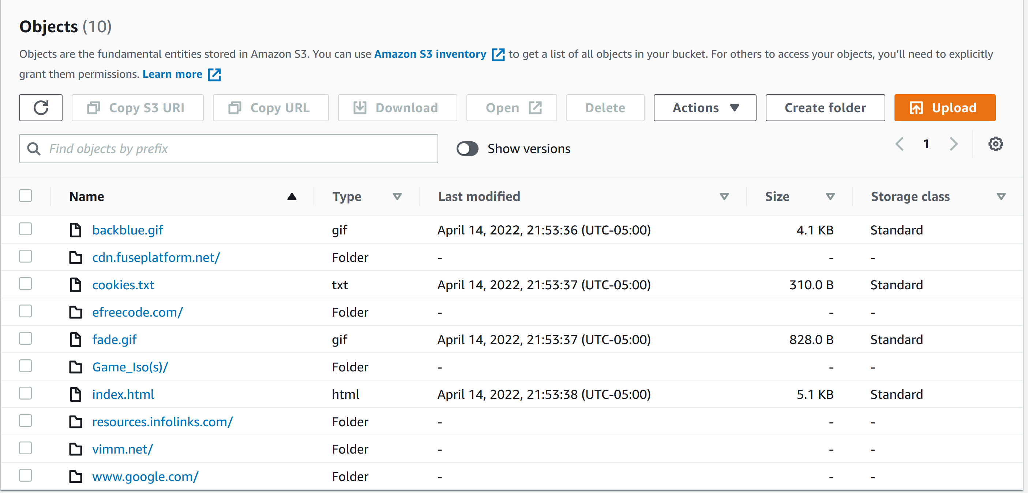
Site Preparations
GameBoy page from Vimm's Lair was cloned using HTTrack
Later uploaded into the S3 bucket called "gamekingdom7"
ISOs from the frontpage of the site were also copied
uploaded into S3 bucket under "Game_Iso(s)" folder

Slide 12

Connecting with HTML
Brackets was used to edit the HTML code to link download buttons to bucket endpoints for each ISO
Once set up, the website was accessible through the URL
http://gamekingdom7.s3-website-us-east-1.amazonaws.com/vimm.net/vault/GB.html

Slide 13

Milestone 3: Website Validation

Slide 14
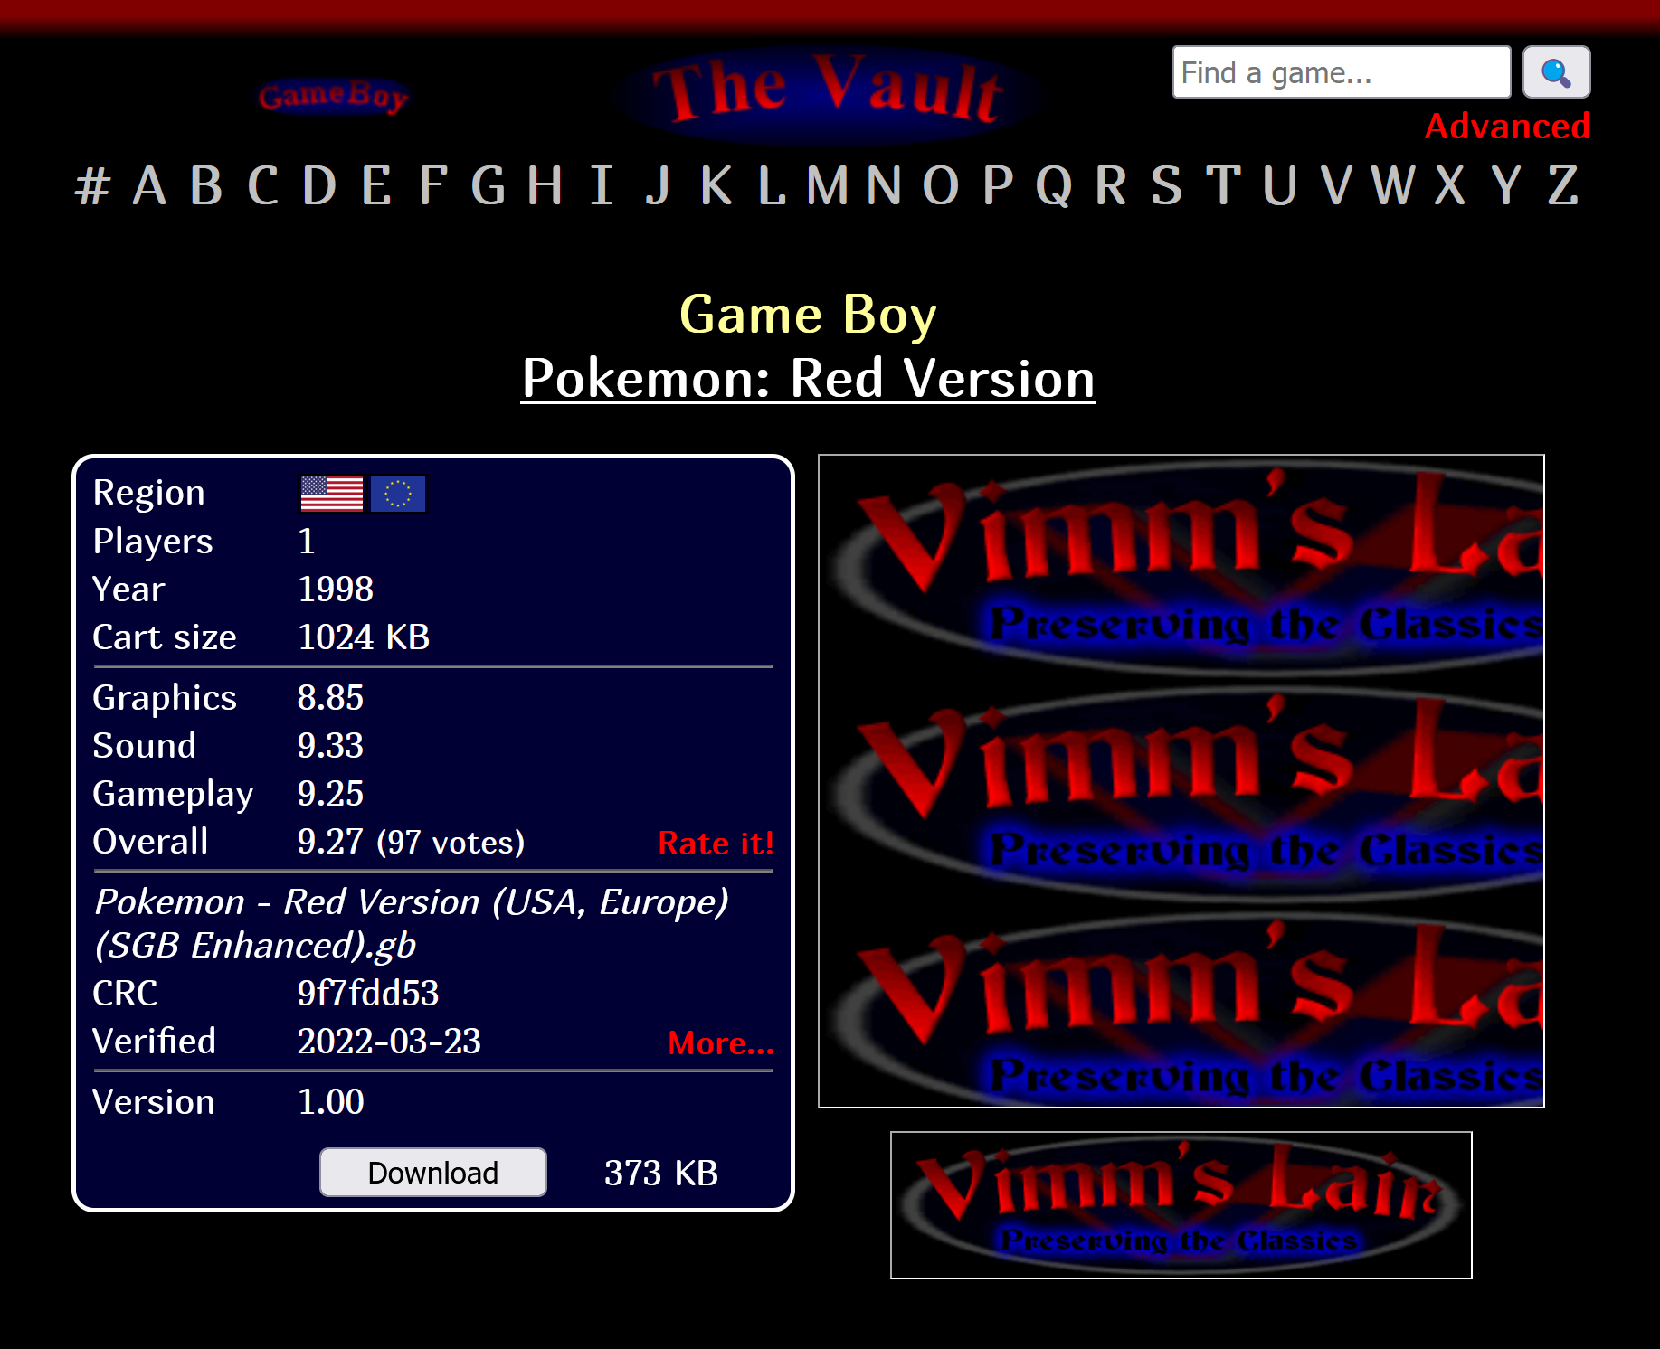
Website Verification
Website game links were tested repeatedly to ensure functionality
Majority of the website is operational and within scope
4 of 15 unique ISO links are nonoperational even after troubleshooting

Slide 15
Deliverables
Deliverable 1: Host Website
Static site hosted through AWS S3
http://gamekingdom7.s3-website-us-east-1.amazonaws.com/vimm.net/vault/GB.html
Deliverable 2: Auto-Scaling
S3 is scalable by default
Deliverable 3: Data Analytics
Gathered through AWS CloudWatch
Other metrics graphed in final report

Slide 16
Professional Accomplishments
Experimented with EC2 instances and CLI before settling on our S3 static website hosting through AWS console.
Learned how to configure an S3 bucket to host a static website.
Edited HTML files to link to specific file endpoints within a bucket.
Utilized CloudWatch to measure traffic metrics.

Slide 17
Citations

Slide 18
Works Cited
[1] https://www.tatvasoft.com/blog/cloud-computing-architecture/
[2] https://stackoverflow.com/questions/62869443/how-to-give-full-access-of-s3-bucket-from-ec2-security-group
[3] https://iwrite.sydney.edu.au/ENGINEERING/Reports/Group-Project-Report/Executive-Summary-examples.html
[4] https://sitesy.com/how-to-host-a-dynamic-website-on-aws/
[5] https://vimm.net/vault/GB/H
[6] https://docs.aws.amazon.com/AmazonS3/latest/userguide/HostingWebsiteOnS3Setup.html#step2-create-bucket-config-as-website
[7] https://stackoverflow.com/questions/60144603/does-s3-auto-scale-by-default
[8] https://austinlasseter.medium.com/how-to-host-a-static-website-on-an-amazon-s3-bucket-be25a613586a

Slide 19
Works Cited (cont.)
[9] https://aws.amazon.com/pm/serv-s3/?trk=1c5ba169-86e9-4c61-8c90-c507636ad817&sc_channel=ps&sc_campaign=acquisition&sc_medium=ACQ-P|PS-GO|Brand|Desktop|SU|Websites|S3|US|EN|Text&s_kwcid=AL!4422!3!536325599730!p!!g!!amazon%20s3%20web%20hosting&ef_id=CjwKCAjwo8-SBhAlEiwAopc9W_oCy4M8GVEbiJ6AdsmeMA8y2kf6YnwvgTvYxIuU2Si3dIpo-o3C-xoC3HYQAvD_BwE:G:s&s_kwcid=AL!4422!3!536325599730!p!!g!!amazon%20s3%20web%20hosting
[10] https://austinlasseter.medium.com/how-to-host-a-static-website-on-an-amazon-s3-bucket-be25a613586a
[11] https://aws.amazon.com/pm/serv-s3/?trk=fecf68c9-3874-4ae2-a7ed-72b6d19c8034&sc_channel=ps&sc_campaign=acquisition&sc_medium=ACQ-P|PS-GO|Brand|Desktop|SU|Storage|S3|US|EN|Text&s_kwcid=AL!4422!3!488982706713!p!!g!!amazons3&ef_id=CjwKCAjwo8-SBhAlEiwAopc9W68FXbJdBW0vxCnZG8knMqQn47B4Qps4SHpNvz-9bVI0-XiZiF5IyRoCRGAQAvD_BwE:G:s&s_kwcid=AL!4422!3!488982706713!p!!g!!amazons3 [12] https://medium.com/@awsgeek/how-to-get-analytics-from-a-website-hosted-on-amazon-s3-36934454e9d3

Slide 20
Works Cited (cont.)
[13] https://docs.aws.amazon.com/AmazonS3/latest/userguide/configure-request-metrics-bucket.html
[14] https://havecamerawilltravel.com/how-allow-public-access-amazon-bucket/
[15] https://docs.aws.amazon.com/AmazonS3/latest/userguide/cloudwatch-monitoring.html
[16] https://docs.aws.amazon.com/AmazonS3/latest/userguide/configure-request-metrics-bucket.html
[17] https://www.cloudsavvyit.com/9534/how-to-enable-and-view-request-metrics-for-an-aws-s3-bucket-in-cloudwatch/
[18] https://docs.aws.amazon.com/AmazonCloudWatch/latest/monitoring/publishingMetrics.html
[19] https://www.youtube.com/watch?v=LfBn5Y1X0vE
[20] https://www.techrepublic.com/article/how-to-clone-a-website-with-httrack/
[21] https://www.cloudcraft.co/

Slide 21
Works Cited (cont.)
[22] How to Get Analytics from a Website Hosted on Amazon S3 | by Jerry Hargrove | Medium
[23] https://docs.aws.amazon.com/AmazonS3/latest/userguide/object-lock-overview.html
[24] https://aws.amazon.com/s3/faqs/
[25] https://docs.aws.amazon.com/AmazonS3/latest/userguide/optimizing-performance.html
[26] https://www.bluefrontier.co.uk/company/blog/item/a-guide-to-http-4xx-errors
[27] https://reqbin.com/Article/HttpGet
[28] https://www.searchenginepeople.com/blog/16081-time-to-first-byte-seo.html
[29] https://docs.aws.amazon.com/AmazonS3/latest/API/API_ListObjects.html
[30] https://developer.att.com/video-optimizer/docs/best-practices/5xx-internal-server-error-best-practices

Slide 22
Works Cited (cont.)
[31] https://www.sumologic.com/blog/monitor-aws-s3-metrics/
[32] https://docs.aws.amazon.com/AmazonS3/latest/userguide/s3-incident-response.html
[33] https://docs.aws.amazon.com/databrew/latest/dg/datasets.multiple-files.html
[34] https://aws.amazon.com/cloudwatch/
[35] https://aws.amazon.com/autoscaling/
[36] https://docs.aws.amazon.com/AmazonS3/latest/API/API_HeadObject.html
[37] https://aws.amazon.com/cloudfront/
[38] https://iconape.com/brackets-2-logo-icon-svg-png.html
[39] https://www.designhill.com/design-blog/essential-graphic-design-tips-for-every-website/
[40] https://usersnap.com/blog/web-application-testing/

